Slide 1
Enterprise Service Bus (ESB)

Slide 2
Agenda
Two views of SOA Foundation Reference Architecture
ESB core principles
Case Studies
Appendix

Slide 3
Introduction
In computing, an enterprise service bus (ESB) refers to a software architecture construct.
This construct is typically implemented by technologies found in a category of middleware infrastructure products,
  usually based on recognized standards, which provide foundational services for more complex architectures via an event-driven and standards-based messaging engine (the bus).

Slide 4
Enterprise Application Integration
An ESB generally provides an abstraction layer on top of an implementation of an enterprise messaging system,
  which allows integration architects to exploit the value of messaging without writing code.
Contrary to the more classical enterprise application integration (EAI) approach of a monolithic stack in a hub and spoke architecture, the foundation of an ESB is built of base functions broken up into their constituent parts,
  with distributed deployment where needed, working in harmony as necessary.

Slide 5
ESB does not implement a service-oriented architecture (SOA) but provides the features with which one may be implemented.
  Although it is a common belief, ESB is not necessarily web-services based.
ESB should be standards-based and flexible, supporting many transport mediums.
Notes:
Most ESB providers now build ESBs to incorporate SOA principles and increase their sales, e.g. Business Process Execution Language (BPEL).
Based on EAI rather than SOA patterns, it tries to remove the coupling between the service called and the transport medium.

Slide 6
What is an Enterprise Service Bus?
There is some disagreement on whether an enterprise service bus is an architectural style, a software product, or a group of software products.
While use of an ESB certainly implies adherence to a particular architecture, the term "enterprise service bus" is almost always used to denote the software infrastructure that enables such an architecture.

Slide 7
ESB Architecture
The word "bus" is a reference to the physical bus that carries bits between devices in a computer.
The enterprise service bus serves an analogous function at a higher level of abstraction.
  In an enterprise architecture making use of an ESB, an application will communicate via the bus, which acts as a message broker between applications.
The primary advantage of such an approach is that it reduces the number of point-to-point connections required to allow applications to communicate.
  This, in turn, makes impact analysis for major software changes simpler and more straightforward.
  By reducing the number of points-of-contact to a particular application, the process of adapting a system to changes in one of its components becomes easier.

Slide 8
ESB as Software (1/4)
Ideally, the ESB should be able to replace all direct contact with the applications on the bus,
  so that all communication takes place via the bus.
In order to achieve this objective, the bus must encapsulate the functionality offered by its component applications in a meaningful way.
  This is typically accomplished through the use of an enterprise message model.
The message model defines a standard set of messages that the ESB will both transmit and receive.
  When it receives a message, it routes it to the appropriate application.
Notes:
In such a complex architecture, the ESB is the piece of software that lies between the business applications and enables communication among them.

Slide 9
ESB as Software (2/4)
Often, because the application was not built with the message model in mind, the ESB will have to transform the message into a legacy format that is understandable by the application.
  The software responsible for affecting these transformations is referred to as an adapter (analogous to a physical adapter).
  It is not widely agreed whether these adapters should be considered part of the ESB or not.
Notes:
In such a complex architecture, the ESB is the piece of software that lies between the business applications and enables communication among them.

Slide 10
ESB as Software (3/4)
The connection between the enterprise message model and the functionality offered by the applications is crucial.
  If the message model does not completely encapsulate the applications' functionality, then other applications that desire that functionality will be forced to bypass the bus and invoke the applications directly.
  Doing so violates all of the principles outlined above, and negates many of the advantages of using an ESB.

Slide 11
ESB as Software (4/4)
To provide further details about the behavior and nature of an ESB necessarily requires using generalities. ESBs are typically built around the exchange of XML messages.
  (As such, the enterprise message model is defined in terms of a series of XML Schema definitions describing the set of legal messages.)
While Web Services are not used exclusively, their use is common, and the message exchange is almost always done in a platform-independent manner.
This allows the ESB to integrate applications that run on a variety of mainframe and client-server operating systems .
Notes:
Further description of an ESB is difficult because it is neither a single product nor a formal standard.

Slide 12
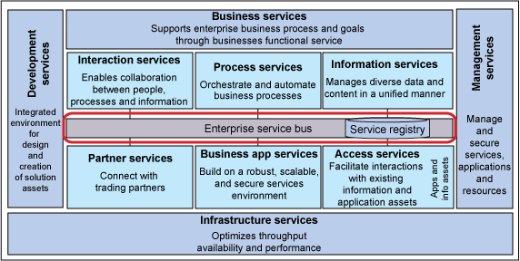
SOA Reference Architecture: logical model view
Notes:
Figure 1 shows the SOA Foundation Reference Architecture logical model view. The logical model view decomposes the functional underpinnings of an SOA solution. This functional or IT-focused view portrays the ESB as an integration part that supplies interconnectivity among other IT parts of a solution.

Slide 13
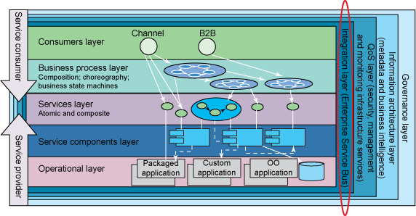
SOA Reference Architecture: solution view
Figure 2:SOA Reference Architecture of a solution view
Notes:
Figure 2 shows the SOA Foundation Reference Architecture solution view. This is a business-focused view of a service-oriented solution. Note the portrayal of the ESB as an integration layer underpinning the interconnectivity among the business parts of the solution.

Slide 14
Two Views of RA
The views of both figures suggest that the ESB is a key architectural pattern in the Foundation reference architecture,
  enabling loosely coupled interconnectivity between service requesters and service providers in service-oriented solutions.
Loose coupling permits a clean separation of concerns (temporal, technological, and organizational) between the parts in a solution,
  enabling flexibility and agility in both business processes and IT systems.

Slide 15

ESB core principles
The logical relationship between service requesters, service providers, and the ESB.
Support for various types of mediation allows the ESB to fulfill two core principles in support of separation of concerns: service virtualization and aspect-oriented connectivity.
Notes:
Service requesters and providers interact by exchanging messages. The ESB, acting as a logical intermediary in the interactions, provides loosely coupled interconnectivity between the requester of a function and the provider of that function. Its role as a logical intermediary allows the ESB to intercept messages and process them as they flow between a service requester and service provider. This processing is called mediation.

Slide 16
The first core principle: service virtualization
Protocol and pattern.
  Interacting participants need not use the same communication protocol or interaction pattern.
    For example, a requester may require interaction through some inherently synchronous protocol, but the service provider may require interaction using an inherently one-way protocol, using two correlated interactions.
  The ESB provides the conversion needed to mask the protocol and pattern switch.
Notes:
Refers to the ability of the ESB to virtualize the following during service interactions:

Slide 17
Interface.
  Service requesters and providers need not agree on the interface for an interaction.
    For example, the requester may use one form of message to retrieve customer information, and the provider may use another form.
  The ESB provides the transformation needed to reconcile the differences.

Slide 18
Identity.
  A participant in an interaction need not know the identity (for example, the address) of other participants in the interaction.
    For example, service requesters need not be aware that a request could be serviced by any of several potential providers at different physical locations. The actual provider is known only to the ESB, and in fact, may change without impact to the requester.
  The ESB provides the routing needed to hide identity.

Slide 19
The second core principle: aspect-oriented connectivity
Service-oriented solutions include multiple cross-cutting aspects
  such as security, management, logging, and auditing.
The ESB can implement or enforce cross-cutting aspects on behalf of service requesters and providers,
  removing such aspects from the concern of the requesters and providers.
The analogy between aspect-oriented connectivity and the more familiar concept of aspect-oriented programming is unmistakable and offers the same value in a different context.

Slide 20
The application of these core principles through mediation allows the ESB to affect the quality of service in interactions.
  Some aspects of an interaction can be abstracted away from the participants. Consider auditing, for example: If a solution requires auditing, the ESB can add it to interactions with no impact on the participants.
  Similarly, the ESB can add to or enhance service-level agreements using its virtualization capabilities to retry failed interactions, or in more sophisticated situations, the ESB can match requester requirements with provider capabilities.
There are limits, however, since some aspects of an interaction cannot be abstracted. For example, the ESB cannot provide a reliable end-to-end interaction if the ESB cannot interact reliably with one of the participants.
Notes:
A Service Level Agreement (frequently SLA) is that part of a service contract where the level of service is formally defined. In practice, the term SLA is sometimes used to refer to the contracted delivery time (of the service) or performance.

Slide 21
An example of ESB core principles (1/2)
A bank has an existing application that must check credit history. The bank is automating its credit-checking process and will use a business partner's credit approval Web service. The existing application interacts with the current credit-checking systems using a text message over MQ, with a correlated response.
Consider a mediation in the bank's ESB that can:
  Listen on an MQ queue and delivers a correlated response to an MQ queue
  Convert a text message from the existing application into a message compliant with the business partner's credit-approval schema and the reverse.
  Interact with the security infrastructure to insert the necessary security information
  Call the business partner’s Web service and leave an audit trail that it has done so

Slide 22
An example of ESB core principles (2/2)
Implementing an ESB as part of the bank's service-oriented architecture provides the following benefits:
  The existing application logic does not change. If the ESB can use the same MQ queues originally used by the application, then even the configuration does not need to change.
  The audit trail supports conciliation of the business agreement with the partner.
  If the business partner's service does not meet its service level agreements, the bank can change to a new service provider by modifying routing and transformations in the ESB without disrupting the client applications using the service.

Slide 23
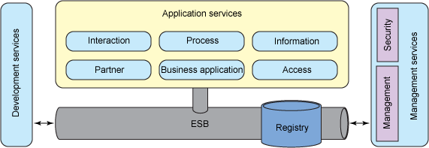
An ESB-centric view of the logical model
ESB-centric view of the logical model
Notes:
Figure 4 portrays a number of important relationships between the ESB and other parts of the reference architecture logical model.

Slide 24
Application logic compared with integration logic
The ESB implements the connectivity or integration logic in a solution.
  This logic performs service virtualization and aspect-oriented connectivity, which is targeted at achieving on demand interconnectivity between application services.
In an ideal service-oriented solution, the separation of application and business logic from connectivity and integration logic is "clean,"
  meaning that the service requesters and service providers (the application services) contain no connectivity or integration logic and that the ESB contains no application or business logic.
Notes:
Only by architecting this clean separation can an enterprise achieve the flexibility, agility, and reuse sought from SOA.

Slide 25
Sometimes it is difficult to distinguish between application and business logic and connectivity and integration logic.
There are no strict guidelines, and, in fact, the choice may depend on the nature of the enterprise or even a particular situation within the enterprise.

Slide 26
One guideline that often works leverages the distinction between semantics and syntax.
  Application and business logic creates, reads, updates, or deletes the semantics associated with achieving business goals.
  Conversely, connectivity and integration logic only modifies syntax associated with achieving the necessary interconnectivity.

Slide 27
A related guideline leverages interaction characteristics.
  Application and business logic is active, in that it creates or consumes the messages (requests and responses) used in service interactions;
  connectivity and integration logic is passive and simply reacts to messages generated by the business logic, simply moving the messages from one participant to another.

Slide 28
Application/business logic versus connectivity/integration logic
The Scenario: A bank has a new application that must check credit history using a call to a Web service.
  The bank wants to use one of two credit reporting services available as Web services from either of two business partners, neither of which exactly matches the bank's data model for credit history.
  The bank wants to use the first business partner's service unless it is not available.
  The new application determines when to call the credit history service and does so using the bank's data model.

Slide 29
Application/business logic versus connectivity/integration logic
The differences:
  The application/business logic in this example consists of the new application plus the two credit reporting services.
  The connectivity and integration logic in this example consists of the processing necessary to transform the credit history model to that appropriate for the credit history service invoked and the failover to call the second business partner if the first fails; this logic is embedded in an ESB as mediation.

Slide 30
Management services
Note that some important capabilities of a service-oriented solution, specifically the management services that are part of any service-oriented solution, are also positioned outside of the ESB.
This is because such capabilities as security and IT management have a solution-wide scope and require the coordination and cooperation of parts of a solution beyond the scope of ESB.

Slide 31
Management services
Note that the ESB does not provide connectivity between application services and management services, and
  it is possible to secure and manage a solution without participation of the ESB.
  It is also possible, and frequently desirable, for the ESB to take an explicit, active role in securing and managing a solution.

Slide 32
Management services
In this situation, the security and management policies are set by the policy administration points outside the ESB, and it's appropriate to consider the ESB as a policy enforcement point for such policies.
  Thus, policy is set using management and security services that have no direct relationship to the ESB, but the ESB helps enforce the policy.
  As a result, management services are characterized as loosely coupled to the ESB.

Slide 33
Service registry
The service registry (sometimes called a service repository or service registry/repository) contains and manages the metadata that describes the services in a service-oriented solution.
  Examples of metadata include interface descriptions, endpoint address, and policies covering service level agreements, security relationships, and so on.
The service metadata contained in the registry, and thus, the registry itself, has a broad scope in service-oriented solutions, spanning governance, development, and administration as well as run time.
Notes:
Figure 2 in particular shows the central nature of the registry in a service-oriented solution; the registry is portrayed as an operational system that spans the vertical stack of layers, from integration through governance.

Slide 34
Service registry
The ESB can provide value using only static metadata provided during development.
Realization of fully autonomic service virtualization and aspect-oriented connectivity, however, requires the ESB to access a services registry at run time to obtain the necessary service metadata to control the dynamic behavior of a solution.
  Thus, we assert that the services registry is the preferred way to configure and control the behavior of the ESB;
  one might say that the service registry is a policy administration point for the policies that control the behavior of the ESB, and that the ESB is a policy enforcement point for the connectivity-related policies in the service registry.
As a result, we can characterize the service registry as tightly coupled to the ESB.
Notes:
Figure 1 and Figure 4 suggest that the ESB requires service metadata to perform service virtualization and aspect-oriented connectivity.

Slide 35
Development services
Developers want to use tools to develop the connectivity and integration logic, or mediations, running in the ESB.
Similarly, administrators can use tools to administer the ESB post-deployment. Ideally, such tools use the services registry.
For example,
  development tooling might allow the mediation developer to find the service providers required for an interaction using the registry.
  Also, administration tooling might allow addition, deletion, or modification of service metadata intended to impact the dynamic behavior of a solution.
Notes:
The development services in Figure 4 provide tools you can use to develop and administer the ESB.

Slide 36
Example of service registry use
A bank has a new application that must check credit history using a call to a Web service.
The bank wants use a credit approval service available as a Web service from a current business partner, but wants to minimize any disruption if it becomes necessary to use a service from a different business partner.
In the simplest scenario, where the interface to any potential business partner is the same interface, the bank uses an ESB mediation that queries the registry for the endpoint address to use in the interaction.

Slide 37
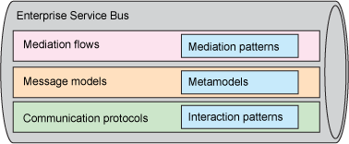
A peek inside the ESB
Figure 5. ESB internal structure
Notes:
Figure 5 shows the first level of detail for the internal structure of the ESB. You can see how the ESB provides service virtualization and aspect-oriented connectivity.

Slide 38
Communication protocols
To enable interaction between service requesters and providers (that is, to receive and deliver messages), the ESB must connect to requesters and providers using communication protocols.
The ESB can leverage different protocols to support differing qualities of service between requesters and providers;
  for example, to support best effort or assured delivery.
The broader the spectrum of protocols an ESB leverages the broader the spectrum of requesters and providers the ESB can interconnect.

Slide 39
Communication protocols
The ESB itself does not actually provide the communication protocols, but instead leverages one or more of the underlying communication fabrics offered by its operating environment
  (the infrastructure services in the SOA Foundation Reference logical model).
You could say that the ESB itself supplies on-ramps and off-ramps or bindings to enable interaction using various protocols.

Slide 40
Communication protocols
Communication protocols inherently support one or more interaction patterns due to characteristics of the underlying communications fabric.
Some common interaction patterns are
  synchronous request/reply,
  one-way (sometimes called event), and
  publish/subscribe (sometimes called event propagation).

Slide 41
Message models
To interact with service requesters and providers, the ESB must support the message models that define the content of the messages used in interactions.
To that end, an ESB must be message-model agnostic and offer the configuration flexibility to support the message models defined by the service requesters and providers.

Slide 42
Message models
A message model itself is based on a meta model, a way of representing message content.
  An example of a message metamodel is the XML Schema definition language; in fact, that is the most common metamodel found in ESB products.
A message model is a specific application of a metamodel; an example of a content model is a specific XML schema.
An ESB must obviously support at least one message metamodel and can support many.

Slide 43
Message models
While the architectural pattern is message-model agnostic, specific ESB products may provide support for a set of cross-industry or industry-specific standard message models,
  such as HL7 in the health care industry.
Support in this case means built-in recognition of the model in the associated tooling and even optimized run-time transformation capability.

Slide 44
Mediation flows
To support the service virtualization and aspect-oriented connectivity necessary in interactions between service requester and providers, the ESB provides mediation flows.
A mediation flow, (commonly shortened to simply mediation), includes
  receiving an inbound request message from a requester through an off-ramp, processing a request message, and then sending an outbound request message to the provider using an on-ramp.
If applicable, a mediation can also include receiving a correlated inbound response message, processing a correlated response message, and sending the outbound response message to the requester.

Slide 45
Mediation flows
The mediation flows in a solution can vary in complexity from very simple to very complex.
The flows can also vary in reusability from unique to a single interaction to applicable to all interactions in a solution or even across solutions.
  Certain types of message processing performed in a mediation flow tend to be highly reusable.
These commonly occurring, highly reusable, well-defined types of message processing are called mediation patterns.
  ESB products can offer one or more prebuilt mediation patterns.
  ESB products that offer more than one prebuilt mediation pattern provide a mediation framework that supports creation of mediation flows through the composition of mediation patterns.

Slide 46
How do mediation flows implement service virtualization?
Virtualization of protocol and pattern implies conversion between different communication protocols and interaction patterns. An ESB can only convert between one protocol and another if it has on-ramps and off-ramps, or bindings, for both.
Conversion between interaction patterns may be inherent with support for the inbound and outbound protocols or may require additional processing. For example, converting from an inbound one-way request using SOAP/HTTP to an outbound one-way request using a queue-based protocol where the message model is the same is inherent because a queue-based protocol is inherently one way.
Conversely, converting between an inbound synchronous request/reply using SOAP/HTTP to an outbound asynchronous request/reply using a queue-based, one-way request with a one-way reply requires the mediation flow to enable correlation between the queue-based request and reply.
Conversion-related mediation patterns include the on- and off-ramps and correlation patterns, although because correlation is core to mediation flows, in many cases, it is implicit in the mediation framework.

Slide 47
Virtualization of interface
Virtualization of interface requires that the ESB support syntactic transformation between the message models defined by the service requesters and providers.
Messages inbound from service requesters using one message model might have to be transformed into the specific message model required by the service provider; any response messages must also be transformed.
Transformation-related mediation patterns include those that allow a single metamodel (for example XSLT), more generic any-to-any transformation patterns that support multiple metamodels, and other forms of message manipulation, such as message enrichment and message filtering (changing syntax, not semantics).

Slide 48
Virtualization of identity
Virtualization of identity requires the ESB to support various forms of routing.
  Routing allows the ESB to send messages from a service requester to a service provider chosen statically (for example, at the time of deployment), or dynamically, based on the conditions at the time of the request.
  Routing mediation flows range from very simple to very complex.
    For example, a simple routing mediation flow might do nothing but supply a different address for the provider; the address might come from a property set at deployment.

Slide 49
Virtualization of identity
A more complex routing mediation flow might do the following:
  Access a service registry to understand the needs of the requester and the offers of the potential providers.
  Use a complex matching algorithm to determine the "correct" provider.
  Perform various conversions and transformations as discussed above.

Slide 50
Virtualization of identity
Routing-related mediation patterns allow simple address manipulation, various forms of registry access, and various forms of decision making.
Larger-grained routing patterns can contribute to differing qualities of service; for example, offering request retry and failover, or even dynamic matching of requester and provider based on policies extracted from a service registry.
An ESB can support more complex and sophisticated routing patterns, such as distribution of a request and correlated aggregation of responses, or even complex event processing.

Slide 51
How do mediation flows implement aspect-oriented connectivity?
The mediation flow may simply log that a request was passed from requester to provider, block requests from unknown or unauthorized requesters, or block requests based on provider availability.
Related mediation patterns include auditing and logging in a manner appropriate for the solution.
Other mediation patterns provide direct or indirect access to the security and management policy definition points so that the mediation flow can perform the appropriate control.

Slide 52
Mediation flows -Summary
From this discussion, it is clear that many mediation flows are likely composed of mediation patterns supporting various forms of service virtualization and aspect-oriented connectivity.
Individual mediation patterns are placed appropriately in the mediation flow to achieve the goals of the intended interaction as well as to enforce management and security policies.

Slide 53
Salient characteristics
"Enterprise Service Bus" is a convenient catch-all term for a set of capabilities, which can be implemented in different ways.
There is considerable debate on whether an ESB is a tangible product or an architectural style, and on exactly how an ESB may be implemented.
  For example, some SOA practitioners claim that SOAP + WS-Addressing is the Bus.
Notes:
(e.g., centralised (broker or hub) versus decentralised (smart endpoints)).

Slide 54
Category | Functions
Invocation | Support for synchronous and asynchronous transport protocols, service mapping (locating and binding)
Routing | Addressability, static/deterministic routing, content-based routing, rules-based routing, policy-based routing
Mediation | Adapters, protocol transformation, service mapping
Messaging | Message processing, message transformation and message enhancement
Process Choreography¹ | Implementation of complex business processes
Service Orchestration² | Coordination of multiple implementation services exposed as a single, aggregate service
Complex Event Processing | Event interpretation, correlation, pattern matching
Other Quality of Service | Security (encryption and signing), reliable delivery, transaction management
Management | Monitoring, audit, logging, metering, admin console, BAM
Notes:
In any case, certain core capabilities are generally accepted as being functions of an ESB:

Slide 55
Salient characteristics
In addition, an ESB is expected to exhibit the following characteristics:
  It is usually operating-system and programming-language agnostic; for example, it should enable interoperability between Java and .NET applications.
  It uses XML (eXtensible Markup Language) as the standard communication language.
  It supports web-services standards.
  It supports various MEPs (Message Exchange Patterns) (e.g., synchronous request/response, asynchronous request/response, send-and-forget, publish/subscribe).
  It includes adapters for supporting integration with legacy systems, possibly based on standards such as JCA
  It includes a standardized security model to authorize, authenticate and audit use of the ESB.

Slide 56
Salient characteristics
In addition, an ESB is expected to exhibit the following characteristics: (Cont’d)
  To facilitate the transformation of data formats and values, it includes transformation services (often via XSLT or XQuery) between the format of the sending application and the receiving application.
  It includes validation against schemas for sending and receiving messages.
  It can uniformly apply business rules, enriching messages from other sources, the splitting and combining of multiple messages and the handling of exceptions.
  It can provide a unified abstraction across multiple layers
  It can route or transform messages conditionally, based on a non-centralized policy (i.e. no central rules-engine needs to be present).
  It supports queuing, holding messages if applications are temporarily unavailable.

Slide 57
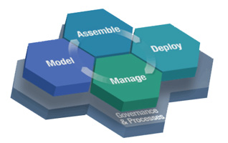
SOA life cycle and the ESB
Figure 6. The SOA Foundation life cycle
Notes:
A key element of a service-oriented solution is the life cycle of its parts. Let's examine how the SOA life cycle applies to the ESB. In Figure 6, you can see the SOA Foundation life cycle.

Slide 58
model phase
The model phase includes the following activities:
  Gathering the interconnectivity and metadata requirements by examination of the service requesters' and providers' interactions; the relevant needs and offerings can be described in the registry.
  Modeling and designing the mediation flows required to support the required interconnectivity.

Slide 59
assemble phase
The assemble phase includes the following activities:
  Composing the mediation flows from smaller-grained mediation patterns. The mediation patterns may be prebuilt, as part of an ESB product. They may exist in an enterprise-specific asset repository. Or, they may be newly developed for the solution.
  Storing metadata about the mediation in the service registry for use by service requesters. The metadata describes the relevant connectivity aspects, such as security.

Slide 60
deploy phase
The deploy phase includes the following activities:
  Configuring the mediations for deployment into a particular run-time topology; some of the necessary configuration information will be in the registry as service metadata.
  Deploying the mediations into one or more run-time environments.
  Modifying the service metadata to impact the dynamic behavior of the solution.

Slide 61
manage phase
The manage phase includes the following activities:
  Monitoring the behavior of service interactions using mediation patterns
  Managing and securing service interactions as a policy enforcement point for security and management services as well as the registry

Slide 62
governance
The ESB plays an indirect part in the governance processes for a service-oriented solution in that governance drives the policies for security, management, and service interactivity.
The ESB, as indicated, can act as a policy enforcement point in these areas.
The ESB must also be factored into governance decisions.
  For example, governance processes determine which services are accessible through the ESB to guarantee loose coupling, and thus, determines which mediations are deployed in the ESB.

Slide 63
Summary
you learned
  how the enterprise service bus is a key architectural pattern in SOA and in IBM's SOA Foundation.
  how the ESB supports service virtualization and aspect-oriented connectivity between interacting participants, in product-independent terms.
The architectural pattern can be implemented using a variety of logical topologies and a variety of middleware technologies and products.

Slide 64
The role of the ESB in SOA
A service oriented architecture enables flexible connectivity of applications or resources by representing every application or resource as a service with a standardized interface.
  This enables them to exchange structured information about business events, including messages, documents, and 'business objects', quickly and flexibly.
This flexibility enables new and existing applications to be easily and quickly combined to address changing business needs, and the ability to easily combine and choreograph applications allows IT services to more readily reflect business processes.

Slide 65
The role of the ESB in SOA
The enterprise service bus and the service oriented architecture are closely linked.
  In fact, the ESB provides the open, standards-based connectivity infrastructure for a service oriented architecture.
Each of the interactions with the ESB ideally makes use of a WSDL based service definition, invoking the required transport services and quality of service.

Slide 66
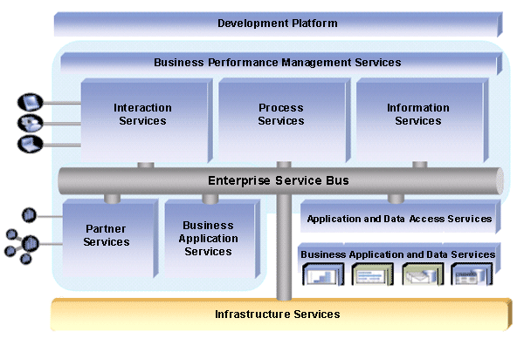
The IBM Business Integration Reference Architecture

Slide 67
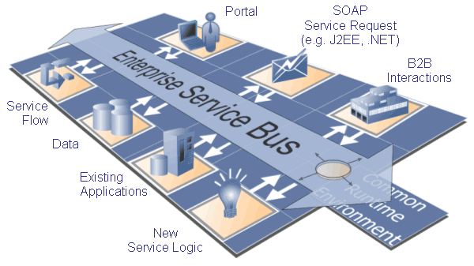

Slide 68
Evolution of the ESB
In order to understand what constitutes an enterprise service bus (ESB), it is helpful to look back at how the use of application software in business has grown over the years.
In many companies, the portfolio of software that they use to run their business today has grown over the years in direct response to their business needs.
Different departments may have grown at varying speeds with different problems to solve, resulting in a mixture of application types and designs across a business.

Slide 69
Evolution of the ESB
Often applications were designed to fulfill a pressing need at the time, with little consideration for how they might be used in the future.
Sharing of data outside the department or even within the same department was often not considered because there was no need for this capability and time and resources were in short supply when the applications were designed.
To further add to the mix of application types and designs, today's company may be the result of a merger or acquisition, each of the component companies bringing their own applications and business data.

Slide 70
Evolution of the ESB
The result of this organic growth is that a company often finds itself with many isolated groups of applications
  that perform well within their own domain but are unable to share their data around the business.
Increasingly this information is needed in other parts of the business, but it is "locked away" in these islands of automation.
One way to solve this problem is to manually re-type the output from one application into another — a time consuming and error-prone way of handling valuable business information.

Slide 71
Evolution of the ESB
An alternative is to write dedicated programs to take the output from one application and transfer it to another application, perhaps with some transformation of the data in the process.
  This "glue" code often contains complex networking code and is written to link two specific applications together.
Generally it cannot be used to connect other applications within the business and needs to be modified if either of the applications are changed or are moved.
This type of connectivity programming is usually complicated, inflexible and expensive to create and maintain.

Slide 72
Founded upon enterprise application integration (EAI)
One way to dramatically cut the cost of integrating business applications is to use message oriented middleware (MOM).
  This enables applications to package their business information as messages, which are handled by the message oriented middleware, for example IBM WebSphere MQ.
WebSphere MQ takes care of distributing messages to where they are needed, thus removing the need to write complex networking code, with all its inherent costs.

Slide 73
Founded upon enterprise application integration (EAI)
Brokering software such as IBM WebSphere Business Integration Message Broker can further enhance the flow and distribution of information
  by enabling the transformation and intelligent routing of messages without the need to change either the applications that are generating the messages or the applications that are consuming them.
This style of connectivity is called a message oriented architecture and is based around applications communicating using messages.

Slide 74
The Role of Web services
The early days of Internet usage was dominated by e-mail and file transfer. Since the mid 1990s the World Wide Web has been hugely successful at giving people access to business applications through Web browsers.
The next wave of Internet usage is the integration of applications running in different computer systems, establishments, organizations and businesses, to automate business operations.
Such loosely coupled applications are called Web services.
  A set of XML-based industry standards has been agreed to facilitate their interconnection.
  A Web service is a self-contained, modular application.
  It is built on standard Internet and XML technologies and described and published to the network for use by other programs.

Slide 75
The Role of Web services
There are three core Web services standards:
  Simple object access protocol (SOAP) is an XML standard for transmitting service request, responses and notifications
  Web services definition language (WSDL) is an XML metadata language for defining the properties of a service
  Universal description, discovery and integration (UDDI) is an XML standard for accessing a service registry

Slide 76
The Role of Web services
Perhaps the most important of these in creating a services oriented architecture is WSDL because it allows the definition of a service to be shared between software development tools, as well as runtimes, from different vendors.
Web services can interoperate over many different transports, including JMS subsystems, WebSphere MQ and the http Internet protocol.
The http protocol offers a common way of connecting middleware from different vendors, but without the security, persistence, reliability and recoverability that comes with messaging middleware.
Various standards bodies are working on addressing many of these limitations, but, to protect their investments, application writers will be well advised to use well supported middleware APIs rather than building in dependencies on evolving standards.
Notes:
Learn more about Web services. A key feature of an ESB is that it can bridge different integration models, enabling, for example, WebSphere MQ applications to interoperate with Web services.

Slide 77
Key benefits
Faster and cheaper accommodation of existing systems.
Increased flexibility; easier to change as requirements change.
Standards-based.
Scales from point solutions to enterprise-wide deployment (distributed bus).
Predefined ready-for-use service types.
More configuration rather than integration coding.
No central rules engine, no central broker.
Incremental changes can be applied with zero down-time; enterprise becomes "refactorable".
Notes:
(please cite reference or explain this.)

Slide 78
Key disadvantages
Enterprise Message Model is usually required, resulting in additional management overhead.
  May not be a simple task to achieve many disparate systems collaborating on message standards.
Requires ongoing management of message versions to ensure the intended benefit of loose coupling.
  Incorrect, insufficient, or incomplete management of message versions can result in tight coupling instead of the intended loose coupling.
It normally requires more hardware than simple point to point messaging.
New skills needed to configure, manage, and operate an ESB.
Extra overhead and increased latency caused by messages traversing the extra ESB layer, especially as compared to point to point communications.
Some critics remark that ESB require a significant effort to implement, but produces no value unless SOA services are subsequently created for the ESB

Slide 79
“ESB-oriented architecture: The wrong approach to adopting SOA”
Bobby Woolf, co-author of Enterprise Application Integration Patterns, and WebSphere SOA and J2EE Consultant at IBM, wrote an article that questions the legitimacy of an ESB as the foundation of a Service Oriented Architecture .

Slide 80
Clients often want to build only an ESB because that involves a technology challenge without the need for messy business requirements.
Building just an ESB becomes an IT field of dreams, where IT builds an ESB and then hopes some SOA will come along and use it.
Such an ESB-oriented architecture loses the benefits of SOA. It does not create business value. In fact, it incurs cost without reaping immediate benefit.

Slide 81
Debate on ESB-oriented Architecture
The debate is serious though and has been on going ever since Dave Chappell coined the catchy term.
In reference to the contract-first debate, deploying an ESB is like starting your SOA with "Connectivity-First".
Notes:
Bobby's article is very entertaining.

Slide 82
Bobby argues the ESB-oriented architecture approach
  ..is inherently flawed in that it builds connectivity no one might ever want to use... Always implement things when you actually need them, never when you just foresee that you need them.

Slide 83
The OASIS SOA Reference Model does not speak about "connectivity" per se, but introduces the notion of a communication infrastructure:
  The primary task of any communication infrastructure is to facilitate the exchange of information and the exchange of intent...Especially in the case where the exchanges are across ownership boundaries, a critical issue is the interpretation of the data. This interpretation MUST be consistent between the participants in the service interaction.

Slide 84
Conventional SOA Reference Architectures, including the one of IBM, always show an ESB in a prominent location.
Dave Chappell explains an ESB is in essence a service container with a dedicated communication infrastructure to connect services that share the same container.

Slide 85
A service container is the physical manifestation of the abstract endpoint, and provides the implementation of the service interface.
A service container is a remote process that can host software components.
In that respect, it has some similarities to an application server container, but with the specific goal of hosting integration services.

Slide 86
Bobby added some clarification to his article:
  "ESBs good; ESB-only projects bad. Orient the architecture around the services, not the bus. Is that clear enough?! :-)"

Slide 87
References
Exploring the Enterprise Service Bus, Part 1: Discover how an ESB can help you meet the requirements for your SOA solution
Exploring the Enterprise Service Bus, Part 2: Why the ESB is a fundamental part of SOA
ESB-oriented architecture: The wrong approach to adopting SOA
David A. Chappell, “Enterprise Service Bus”, O’Reilly, 2004.
Bruce Silver Associates, “Enterprise Service Bus Technology for Real-World Solutions”, Industry trend reports, Aug. 2004.
BEA, “Service Infrastructure Overview”, July 2005.
Cape Clear, “Cape Clear’s Enterprise Service Bus (ESB)”, 2005.
“Patterns: Implementing an SOA Using an Enterprise Service Bus”, IBM Red Book (SG24-6346-00), July 2004.
“Getting Started with Websphere ESB”, IBM Red Book (SG24-7212-00), June 2006.
“紧紧抓住整合的钥匙：中间件架构概念ESB”, IT经理世界，林建 。

Slide 88
Case Studies
BlueSky Company Project
  Integration
BlueMart
  Reimbursement
BlueSquare
  Process and Data Integration

Slide 89
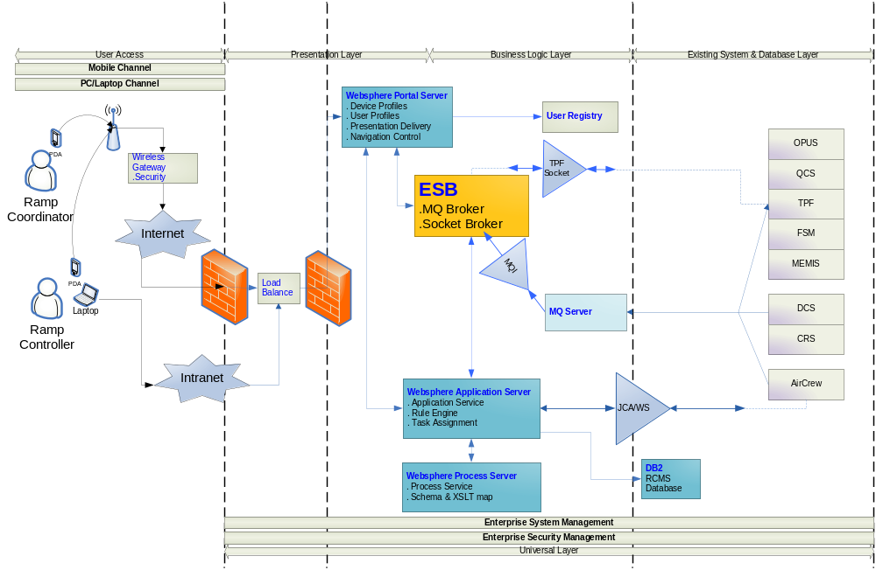
BuleSky: ESB在RCMS系统中的 位置

Slide 90
ESB在RCMS中的用途
RCMS与原有遗留系统整合，是通过消息的方式进行的。遗留系统向RCMS发送消息，来触发RCMS执行相应的动作。
因为存在多种遗留系统，不同遗留系统发送的消息是不一样的，那么需要一个中介来将不同的消息格式转变为同一种消息格式，从而传递给RCMS进行处理。
将不同的消息转变为同一种消息格式再传递给RCMS，这就是这个系统中ESB的用途。
ESB转换
不同格式的消息
相同格式的消息

Slide 91
消息的获取方式
ESB获取遗留系统的消息有两种方式
  MQ
    MQ方式是通过MQ服务器的队列存储遗留系统的消息，ESB取得MQ服务器上队列中的消息，进行处理。（不用自己写存储转发程序，稳定安全且具有事物功能）
  Socket
    通过直接的Socket网络编程，进行消息的获取。（速度快）
    MQ
遗留系统发送消息到队列
队列
ESB监听队列消息，一旦有消息，则获取
Socket服务器
遗留系统通过Socket编程发送消息
Socket服务器接收到消息
直接触发ESB的转换功能来转换消息

Slide 92
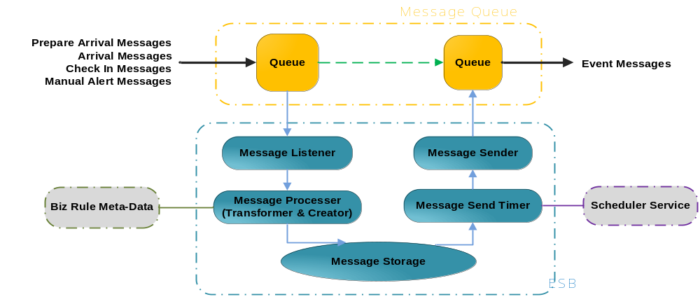
MQ方式ESB的实现原理
Transformation、Routing、Integration、Transferring
存放转换成统一格式后消息
存放遗留系统不同消息
Notes:
Business Rule Meta-Data是一些业务规则，根据这些规则处理消息，产生新的数据保存在数据库中。
Scheduler Service是一种轮询机制，每隔30秒轮询一次message storage的数据库，Scheduler是在WAS注册的服务，它随着WAS的启动启动。后面的PPT有进一步的解释。

Slide 93
不同格式的消息类别
  Prepare Arrival Message
  Arrival Message
  Check In Message
  Manual Alert Message

Slide 94
一些不同格式的输入消息
<ManualAlert>
  <rcuid>Lee</rcuid>
  <fltno>KE 1235 </fltno>
  <subject>pressure of feuling pipe is lower</subject>
  <actions>check refeuling process and equipment</actions>
</ManualAlert>
<PrepareArrival>
  <fltno>KE 1100</fltno>
  <stn>GMP</stn>
  <sdate>0116</sdate>
  <regnum>HL7299</regnum>
  <stime>1340</stime>
</PrepareArrival>

Slide 95
一些不同格式的输入消息
<Arrival>
  <fltno>KE 1100</fltno>
  <stn>GMP</stn>
  <sdate>0116</sdate>
  <regnum>HL7299</regnum>
  <stime>1430</stime>
</Arrival>
<CheckIn>
  <fltno>KE 1109</fltno>
  <depstn>GMP</depstn>
  <clstime>0930</clstime>
</CheckIn>

Slide 96
相同格式的消息类别
相同格式的消息类别
  Prepare Arrival Message
  Arrival Message
  Check In Message
  Manual Alert Message
  Auto Alert Message
动作消息，这三种格式一样
提醒消息，这两种格式一样

Slide 97
提醒消息统一格式的例子
<alert>
<type>auto</type>
<altid>XXXXX</altid>
</alert>
这个auto alert message是由输入的消息经过一系列处理之后得到的新的消息
<alert>
<type>manual</type>
<altid>XXXXX</altid>
</alert>

Slide 98
Business Rule Meta Data and Scheduler
Prepare Arrival Message
KE 1100
GMP
0116
。。。。。。
查询数据库，根据一些业务规则和原数据，产生新的Alert数据
定期轮询数据库，根据触发 的数据产生新的消息
Flight information
Activity during prepare arrival step
Activity Instance
Alert Instance
Find Alert Instance which should be alerted
Business Rule Meta Data

Slide 99
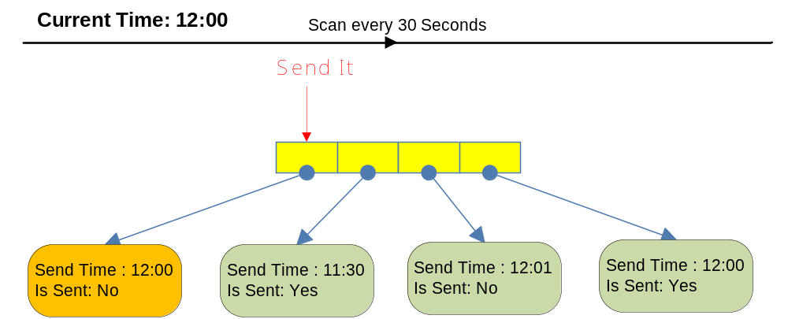
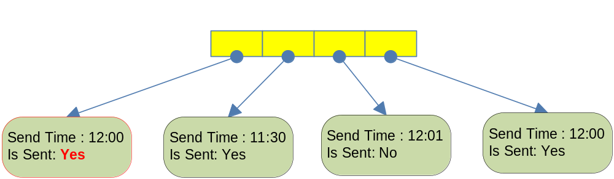
Scheduler Service
Scheduler
Notes:
使用例程服务来定时发送消息

Slide 100
MQ方式下ESB相关模块功能解释
Message Listener与Message Sender:利用JMS API 实现的MDB 和 JAVA 类
  Listener监听一个MQ的队列，是MDB。得到输入消息后调用一系列处理活动
  Sender是一个java类，将传递给它的消息发送到指定的消息队列中去。以供其它的应用程序使用消息。

Slide 101
JMS与MDB简介
JMS对象模型
使用 JMS API可以将消息发送到消息中间件，或者从消息中间件接受消息
Connection Factory
create
Connection
create
Message Producer
session
Message Consumer
Send
create
create
create
Send
Destination
Message
Destination

Slide 102
Message Driven Bean (MDB)
  消息驱动Bean是一种EJB,它可以很方便地监听到某个队列上的消息，只用使用一个onMessage方法。
  public void onMessage(Message m){
  TextMessage msg=(TextMessage)m;
  try{
  System.out.println(msg.getText());
  }
  catch(JMSException e) {
  e.printStackTrace();
  }
  }

Slide 103
MQ方式下ESB相关模块功能解释
Message Processor
  Message Processor是由command模式提供的一系列消息处理器，对于每种不同的消息，调用不同的command。处理器主要从原始消息中提取一些业务的数据，存储在数据库中（message storage），以便生成新的消息。这些数据包括有哪些人员活动，活动开始的时间，活动的状态，活动超时的时间等等。

Slide 104
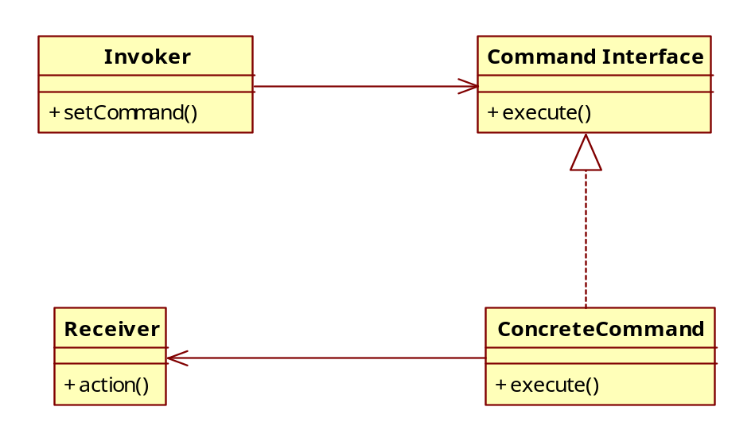
采用Command设计模式实现对消息的处理
持有一个Command对象，并在某个时间点调用execute（），执行某个命令

Slide 105
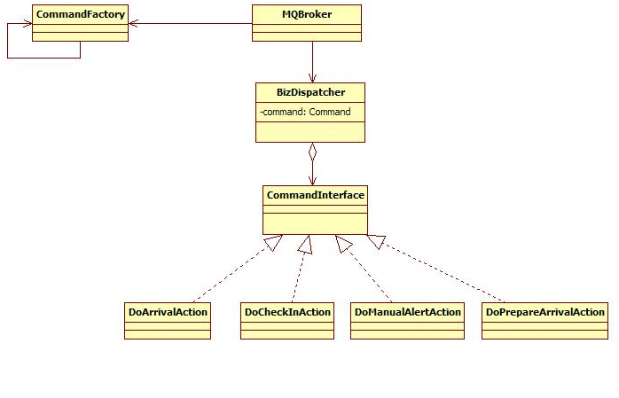
灵活使用Command设计模式
顶层和底层都依赖于接口编程
对于command的实例化，使用工厂类从配置文件中读出。
新增加一个消息只用新增加一个concrete command,不用重新编译其他的类

Slide 106
MQ方式下ESB相关模块功能解释
Message Sender Timer
  利用WAS的scheduler服务，定期扫描数据库message storage，根据触发的数据，生成新的消息auto alert。
上面的这些功能，实现了以MQ为基础，使用JMS API，实现对消息的异步、存储转发。通过数据库和一些列的java类，实现对消息的转换。以及通过对xml格式的消息文件的处理，实现系统的集成。

Slide 107
Case Studies
BlueSky Company Project
  Integration
BlueMart
  Reimbursement
BlueSquare
  Process and Data Integration

Slide 108
Purpose
Simplifies integration and reuse of business components within SOA
Connects disparate applications and IT resources
Mediates incompatibilities, orchestrates interactions
Makes services broadly available for additional uses
Reference

Slide 109
Mediation
Data Format Transformation
  SOAP, XML, User Defined Data Format …
Protocol Transformation
  Http, JMS, MQ …
Interaction Patterns Mediation
  Request/Response, One Way, Publish/Subscribe
Message Routing
Validation, Logging, Security …
  Reference

Slide 110
Relationship of services
UI Presentation
Process Business
Payment
Service
Charge Up
Service
Email
Service
SMS
Service

Slide 111
Analysis 1
Process & Backing Services
  - Process calls Backing Services
  - There are incompatibilities between them
  ESB should wrap these services for process
  More about MQ More about SOAP
Contract | Process | Backing Services
Platform | J2EE | J2EE
Interface Type | Web Service [request] | Web Service (ChargeUp, Payment), Servlet (Email), MQ (SMS) [provide]
Data Type | SOAP | SOAP, XML
Protocol | SOAP\HTTP | SOAP\HTTP, Post\HTTP, MQ

Slide 112
Analysis 2
UI & Process
- UI calls Process, and they are both base on J2EE
  - Process provides Java API, UI can use it easily
  No incompatibility need to be reconciled
  ESB does not have to wrap process for a while
Contract | UI | Process
Platform | J2EE | J2EE
Interface Type | Java API [request] | Java API [provide]
Data Type | Simple Data Format | Simple Data Format

Slide 113
Extension 1
About UI & Process
  ESB can wrap the process as a service to be called by UI
  It will accord with standard of “Service Oriented” and “loosely-coupled” much more
  Differences between non-wrapped process and wrapped process are small in our environment
  But in some complex environment, such as different platform, wrapping by ESB is necessary

Slide 114
Extension 2
About ESB & Service
  Every thing should be regarded as service in SOA
  Granularity of service can be large or small, large granular such as process and small granular such as component
  Integration of service should via ESB
  BUT different status may result in different solution

Slide 115
References
JMS tutorial: http://mediasrv.ns.ac.yu/extra/java2/tutorials/jms_tutorial/doc/jms_tutorialTOC.html
JMS: http://en.wikipedia.org/wiki/Java_Message_Service
Middleware: http://www.sei.cmu.edu/str/descriptions/middleware.html

Slide 116
Appendix
Separation of Concerns
Service Level Agreement (SLA)

Slide 117
Separation of concerns
In computer science, separation of concerns (SoC) is the process of breaking a computer program into distinct features that overlap in functionality as little as possible.
  A concern is any piece of interest or focus in a program. Typically, concerns are synonymous with features or behaviors.
Progress towards SoC is traditionally achieved through modularity and encapsulation, with the help of information hiding.

Slide 118
All programming paradigms aid developers in the process of improving SoC. For example,
  object-oriented programming languages such as Java can separate concerns into objects, and
  a design pattern like MVC can separate content from presentation and data-processing (model) from content.
  Service-oriented design can separate concerns into services.
  Procedural programming languages such as C and Pascal can separate concerns into procedures.
  Aspect-oriented programming languages can separate concerns into aspects and objects.

Slide 119
Separation of concerns is an important design principle in many other areas as well, such as urban planning, architecture and information design.
  The goal is to design systems so that functions can be optimized independently of other functions, so that failure of one function does not cause other functions to fail, and in general to make it easier to understand, design and manage complex interdependent systems.
Common examples include using corridors to connect rooms rather than having rooms open directly into each other, and keeping the stove on one circuit and the lights on another.

Slide 120
A programming paradigm is a fundamental style of computer programming. (Compare with a methodology, which is a style of solving specific software engineering problems).
A programming language can support multiple paradigms. For example programs written in C++ or Object Pascal can be purely procedural, or purely object-oriented, or contain elements of both paradigms. Software designers and programmers decide how to use those paradigm elements.
In object-oriented programming, programmers can think of a program as a collection of interacting objects, while in functional programming a program can be thought of as a sequence of stateless function evaluations. When programming computers or systems with many processors, process oriented programming allows programmers to think about applications as sets of concurrent processes acting upon logically shared data structures.

Slide 121
Service Level Agreement (SLA)
A service level agreement is a document which defines the relationship between two parties: the provider and the recipient.
This is clearly an extremely important item of documentation for both parties. If used properly it should:
  Identify and define the customer’s needs
  Provide a framework for understanding
  Simplify complex issues
  Reduce areas of conflict
  Encourage dialog in the event of disputes
  Eliminate unrealistic expectations

Slide 122
Specifically it should embrace a wide range of issues. Amongst these are usually the following:
  Services to be delivered
  Performance, Tracking and Reporting
  Problem Management
  Legal Compliance and Resolution of Disputes
  Customer Duties and Responsibilities
  Security
  IPR and Confidential Information
  Termination

Slide 123
References
http://en.wikipedia.org/wiki/Service_level_agreement

